Slide 1






Instant and Robust Authentication and Key Agreement among Mobile Devices
Wei Xi¹, Chen Qian², Jinsong Han¹, Kun Zhao¹
Sheng Zhong³, Xiang-Yang Li⁴, Jizhong Zhao¹

Slide 2


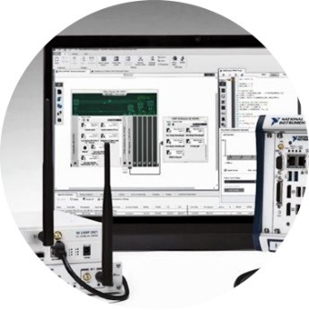
Overview
Part Ⅰ
Part Ⅱ
Part Ⅲ
Motivation
The Dancing Signals
Experiment Results
Background
State-of-the-art
Observation
TDS design
Analysis and discussion
Experiment setup
Performance evaluation
02
ACM CCS 2016 – The Dancing Signals (TDS)
02
Notes:
This is the outline of today’s presentation. First, I would like to introduce the background of this work.

Slide 3
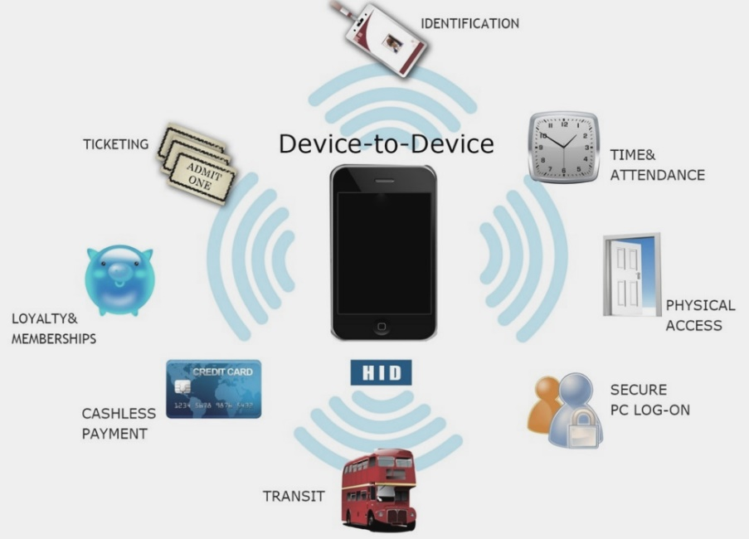
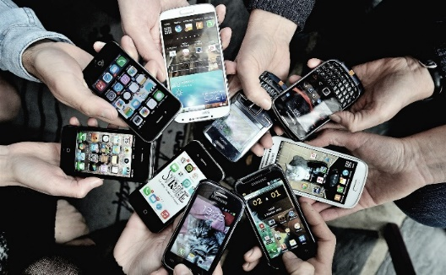

Background
ACM CCS 2016 – The Dancing Signals (TDS)
03
Notes:
With the popularity of mobile devices, wireless device-to-device communication is playing important roles for many emerging applications, including online payments, gaming, and social networks.
Hence the authentication and key agreement among mobile devices is critical for securing such interactions.
Imagine there is a number of people meeting in this year’s CCS. They are strange to each other. But they have a nice conversation. Then they want to add each other as friends over the social Apps, such as WhatsApp Messenger or WeChat. This task would be difficult because those people do not have trusted basis or connections.
However, they can be physically close to each other, for example, sitting around a table.
Therefore, if there is an authentication mechanism allowing nearby people to trust each other and share a secret key, we can easily achieve the objective.

Slide 4
State-of-the-art
KinWrite: Handwriting-Based Authentication Using Kinect
NDSS’13
Authenticating Privately over Public Wi-Fi Hotspots
CCS’15
Heart-to-Heart (H2H): Authentication for Implanted Medical Devices
CCS’13
Checksum Gestures: Continuous Gestures as an Out-of-Band Channel for Secure Pairing
UbiComp'15
2011
2013
2014
2015
2016
ProxiMate: proximity-based secure pairing using ambient wireless signals
MobiSys'11
Authentication Using Pulse-Response Biometrics
NDSS’14
PhotoProof: Cryptographic Image Authentication for Any Set of Permissible Transformations
S&P'16
Good Neighbor: Ad hoc Pairing of Nearby Wireless Devices by Multiple Antennas
NDSS’11
Commitment-based device pairing with synchronized drawing
PerCom’14
ACM CCS 2016 – The Dancing Signals (TDS)
04
Notes:
Recently, researchers have made extensive efforts in the device authentication and key agreement. The essential goal of those works is to reduce the amount of user interactions required for manual key assignment and delivery.
The mainstream method is to leverage the physical proximity. Because of the common radio environment, the devices can prove their identities to others, and use the common environment to generate a same secure key.
In this way, we do not need trustworthy authority to setup keys and complicated high-level key distribution schemes.
However, the main limitations of the previous works is the slow speed of key generation and high error rate. They usually require holding two devices in a physical proximity for even several MINUTES before communication. It is obviously inconvenient in most applications.
These solutions are also hardly to expand to more than two devices. Last but not the least, some of them are vulnerable to various attacks, such as a man-in-the-middle attack and identity spoofing attack.

Slide 5

Use Wi-Fi to share information among users nearby
Without human intervention
Good performance in safety and efficiency
/ Our Goals
ACM CCS 2016 – The Dancing Signals (TDS)
05
Notes:
The goal of our system is to share information among users nearby using wifi, without human intervention, and to achieve good performance in both safety and efficiency.

Slide 6



Proximate-based Pairing
Eve
Use a public Wi-Fi source for secure pairing
d>>λ/2
Proximate-based Pairing
Public Wi-Fi Source
Calvin
Use this source to generate a secret key at Alice, Bob and Calvin
If K_{Alice} = K_{Bob} = K_{Calvin}, then Alice, Bob & Calvin know they are in proximity
Use the key for encrypting all further communication
Alice
Bob
d<λ/2
ACM CCS 2016 – The Dancing Signals (TDS)
06
Notes:
In this work, we design and implement an authentication and key agreement protocol for mobile devices with instant and robust key agreement.
We assume that multiple legitimate users, for instance Alice, Bob, and Calvin, are interested in securely exchanging their private information. They are able to communicate via Wi-Fi devices, say their cellphones. They have no prior shared secret.
To perform the key agreement, they put their devices in physical proximity such that the distance between any two device is less than an authentication distance (0.4λ ≈ 5cm@2.4GHz where λ is the wavelength). A malicious device, say Eve, is located beyond a safe distance (λ ≈ 12.5cm for Wi-Fi) to Alice. If Eve moves into the safe distance, it will be easily seen by the legitimate users, Alice and Bob.
Alice, Bob, Calvin and Eve can hear a public wireless source Peter.
Eve can sense the wireless environment, inject new traffics, and replay packets. Eve can perform various attacks including spoofing, eavesdropping, and man in-the-middle. Due to physical proximity, Alice, Bob and Calvin can share common random source and generate secret key. While Eve cannot obtain any information beyond such a distance.

Slide 7
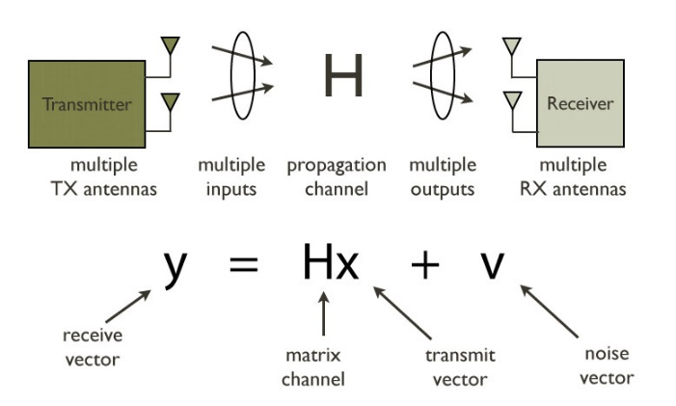
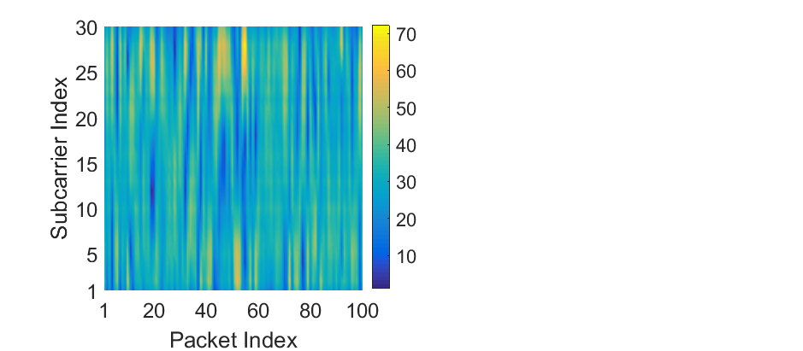
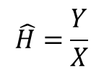
Observation
$$\hat{H}=\frac{Y}{X}$$
Rx signal
Tx signal
CSI estimation
Decorrelation in space and time
Multiple Subcarriers
Space: Over distances of ∼ λ/2 (= 6 cm @ 2.4 GHz)
Time: Over coherence time (∼ 100 msec @ 2.4 GHz)
In OFDM, a channel is orthogonally divided into multiple subcarriers.
ACM CCS 2016 – The Dancing Signals (TDS)
07
Notes:
Here, a question raises: what random resource we should use.
In current WiFi system, CSI is channel state information available from Orthogonal Frequency Division Multiplexing (OFDM) of the current Wi-Fi standard.
Recent research suggests that CSI has good decorrelation and reciprocity properties.
In the left figure, the X, Y axis denote the packet index and CSI amplitudes, respectively. , Since Alice and Bob are located less than half wavelength, We can see that, their CSI amplitudes are highly similar. On the contrary, since Eve is beyond a safe distance, Its CSI amplitudes is much different from those of Alice and Bob. Furthermore, CSI has many subcarriers, we can obtain 30 subcarriers through commercial devices, and each subcarrier can measure a CSI sample. In the right figure, we can see that the variance of CSI is very large. This means when generating secret keys, using CSI as random source will be much faster than using RSS.
So we can leverage the CSI as the common random source.

Slide 8
Opportunities & challenges
Opportunities & challenges
1
Multiple subcarriers
2
Sensitive to environment
3
Rapid spatial decorrelation
4
High correlation among subcarriers
ACM CCS 2016 – The Dancing Signals (TDS)
08
Notes:
Using CSI as the random source offers two opportunities:
First, since CSI is sensitive to environment changes, legitimate users only need to maintain vigilance in a small-range.
Second, CSI has multiple subcarriers and we can get much richer entropy than RSS.
However, we still face two challenges:
First, due to rapid spatial decorrelation, the devices should be located close enough to obtain similar CSI estimations.
Second, because of high correlation among subcarriers, not all the subcarriers can be used in key generation.

Slide 9



Main idea
Alice
Bob
It is difficult to extract identical key from similar channel estimation.
It is much easier to extract similar features among nearby devices.
Why not use the similar features instead of identical key to encipher and decipher information?
ACM CCS 2016 – The Dancing Signals (TDS)
09
Notes:
Hence, there should be a fault-tolerant and robust authentication method using CSI. Otherwise, CSI will introduce troubles rather than opportunities.
Intuitively, it is difficult to extract identical key from similar channel estimation. However, it is much easier to extract similar features among nearby devices’ estimations. We are inspired to use the similar features instead of identical key to encipher and decipher information.

Slide 10
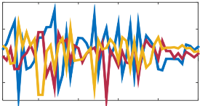
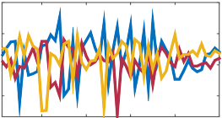
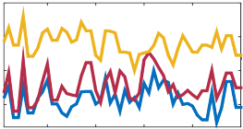

Main idea
Must be the key symmetrically identical ?
Alice
Bob
Eve
0
1
Similar, but not identical
0
1
Eve’s is quite different…
0
1
Alice wants to secretly send “0”
Compare the received “texture” with the local
95%
5%
20%
50%
Bob gets “0”
with 95% confidence
Eve gets “1”
with only 50% confidence
ACM CCS 2016 – The Dancing Signals (TDS)
10
Notes:
I will give an example to illustrate our solution. Suppose that Alice and Bob want to share some secret information. They are close to each other to listen to the public wifi. Eve is also listening to the same wifi, but distant from Alice and Bob. Eve also monitors the messages shared between Alice and Bob. Based on each CSI estimation, instead of reporting the detail data, Alice extract the feature of the estimation, and split it into two parts. She then uses the first part to represent ‘0’ , and the second part for ‘1’. Bob and Eve do the same thing with their own estimations.
When Alice wants to deliver “0” to Bob, she broadcasts the first part. Bob compares the received part with the two local parts of its own. Since Bob has a similar CSI estimation, he deduces “0” with a high confidence. In contrast, since Eve’s CSI is quite different from that of Alice and Bob’s, she will get ``0’’ and ``1’’ with the same probability, say, 20% of 0 and 50% of 1, just like randomly guessing.

Slide 11
TDS Working Process
1. Channel sampling
2. S-box Generation
Alice broadcasts a message to other devices and ask them (including Alice) to start listening to a same public Wi-Fi source.
S-box includes a number of blocks. Each block contains a number of samples and represents a bit 0 or 1
1
2
5
5. Information reconciliation
3. Key generation
3
Alice and Bob need to ensure that they obtain a same key and correct the mismatch bits, which are very few in TDS.
Alice may use any key generation method to determine a strong secret key with high randomness and entropy.
4
4. Key delivery
Alice selects a block from every pair to represent
whether this bit is 0 or 1. Bob only needs to decide whether the i_{th} block is more similar to his i_{th} 0-block
or his i_{th} 1-block.
ACM CCS 2016 – The Dancing Signals (TDS)
11
Notes:
Base on the above main idea, we list our work- TDS’s Working Process as follows:
1…Alice initializes the process by broadcasting a message to other devices.
2…Alice prepares an S-box. The S-box contains a number of block pairs. Each block pair corresponds to a number of CSI estimations to deliver one bit. And one block represents 0 and the other represents 1.
3…Alice generates a random key using any effective key generation method.
4…Alice map each bit in the key to a block in the S-box. For example, the i-th bit is 0, then Alice selects the 0-block from the i-th block pair, and sends feature of this block to Bob.
5…Bob checks which block in its i-th block pair has the feature that best matches the received one. Bob then yields the same bit. After recover all bits, Bob retrieves the entire key.

Slide 12
CSI correlations
The adjacent subcarriers have very strong CSI correlation, and the correlation oscillates with increasing of the difference of two subcarriers’ indexes.
Subcarrier pairs {2, 4} and {7, 9} will have a similar difference, S₂ − S₄ ≈ S₇ − S₉.
ACM CCS 2016 – The Dancing Signals (TDS)
12
Notes:
However, it does not work to directly use the complete CSI estimation. This is because the adjacent subcarriers have very strong correlation. As a result, the entropy of the formed blocks would be much small, reducing the quality of keys.
We draw the correlation among different subcarriers in the left figure. The bright color denotes positive correlation while the dark color implies the negative. We see that the adjacent subcarriers have very strong CSI correlation.
The right figure shows the correlation between two different subcarriers. The dark blue curve plots the correlation between the 1st subcarrier and the x-th subcarrier. The 1st subcarrier has the strongest correlation with the 2nd subcarrier, and the least correlation with the 11th subcarrier. The difference between any pair of subcarriers that are with a fixed difference of indexes is very small. We can see the correlation oscillates when increasing the difference of two subcarriers’ indexes.
For example, subcarrier pairs {2, 4} and {7, 9} will have a similar difference.

Slide 13
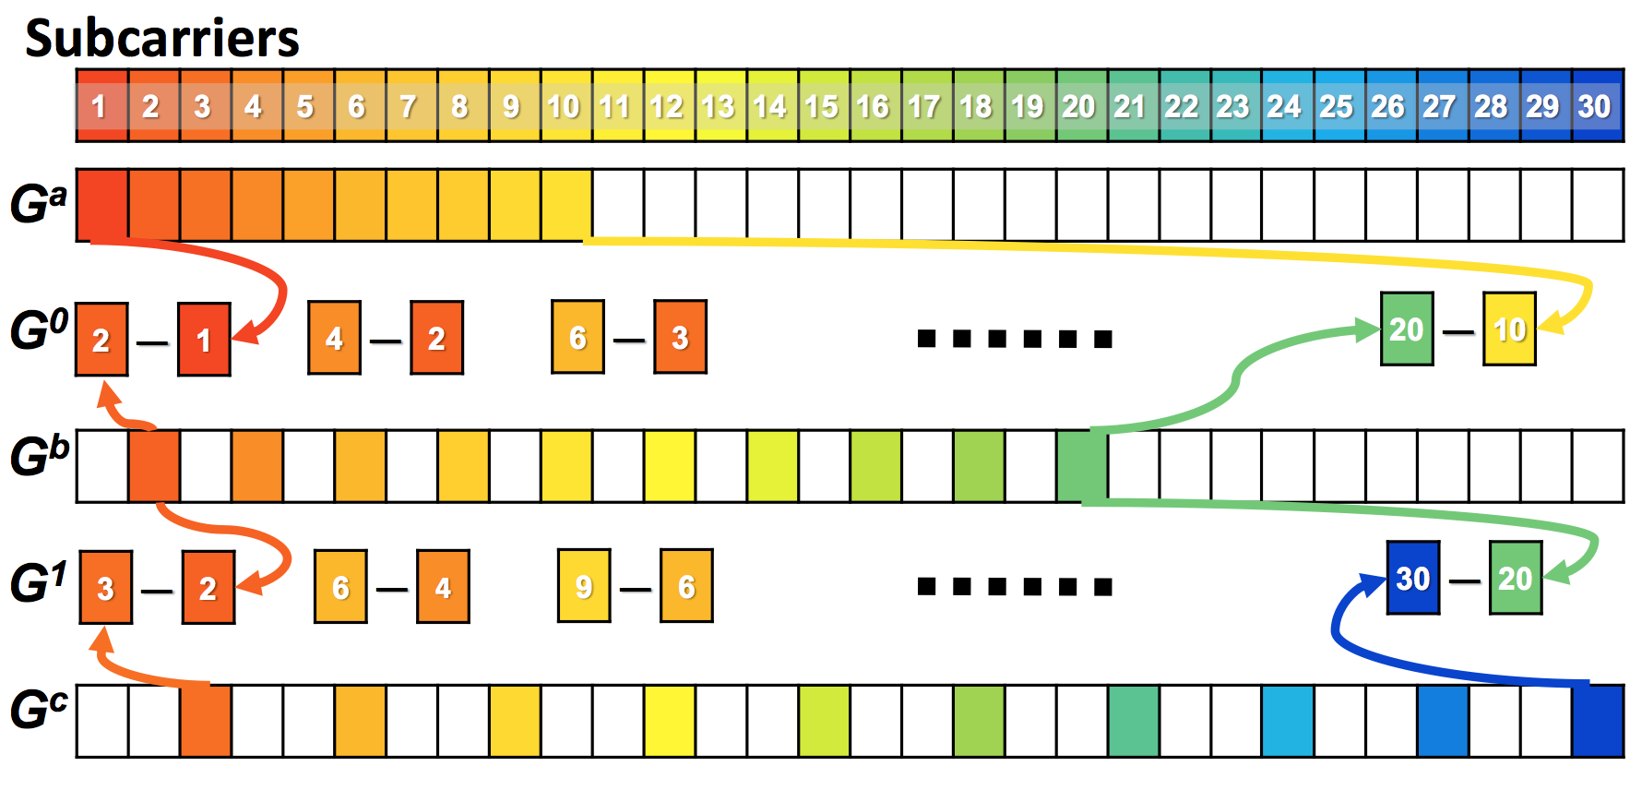
Group allocation
ACM CCS 2016 – The Dancing Signals (TDS)
13
Notes:
We then design a novel block generation scheme. I just explain the brief steps of block generation. For every single bit to be delivered, we first setup three groups over the CSI estimations from the 30 subcarriers.
The first group sequentially chooses the estimated CSI data from subcarrier 1 to 10. The second group will contain subcarriers 2, 4, 6, 8, …, 20, actually every other subcarrier is chosen.
The third group will contain 3, 6, 9, 12, …30, so every third subcarrier will be chosen to this group.
Then we have three groups, Ga, Gb, and Gc, each has 10 subcarriers’ estimations.
We then further generate two groups, G0= Gb – Ga, and G1 = Gc – Gb.
The purpose of subtraction here will be explained later.
Finally, the G0 will be the part to represent 0, and G1 will represent 1.

Slide 14
Feature extraction
0
1
0
1
We use the second value in each group as the feature, which are very different between G⁰ and G¹.
$$G_{m×n}=U_{m×m}{\hat{Σ}}_{m×n}V_{n×n}^{T}=Σ{\hat{σ}}_{i}u_{i}v_{i}^{T}$$
ACM CCS 2016 – The Dancing Signals (TDS)
14
Notes:
Since the two parts of a block are two matrices, we leverage singular values to represent their features.
In particular, we use the second singular value in each part as the feature, which are very different between G⁰ and G¹.
The reason is that According to SVD theory,
a matrix can be re-written as the sum of multiple 1-rank matrix with scale value which equals to singular value.
Based on the analysis of many experiments, it to optimal to use the 2nd or 3rd singular values as the feature of a block.
We suggests to use the second value in most case.

Slide 15
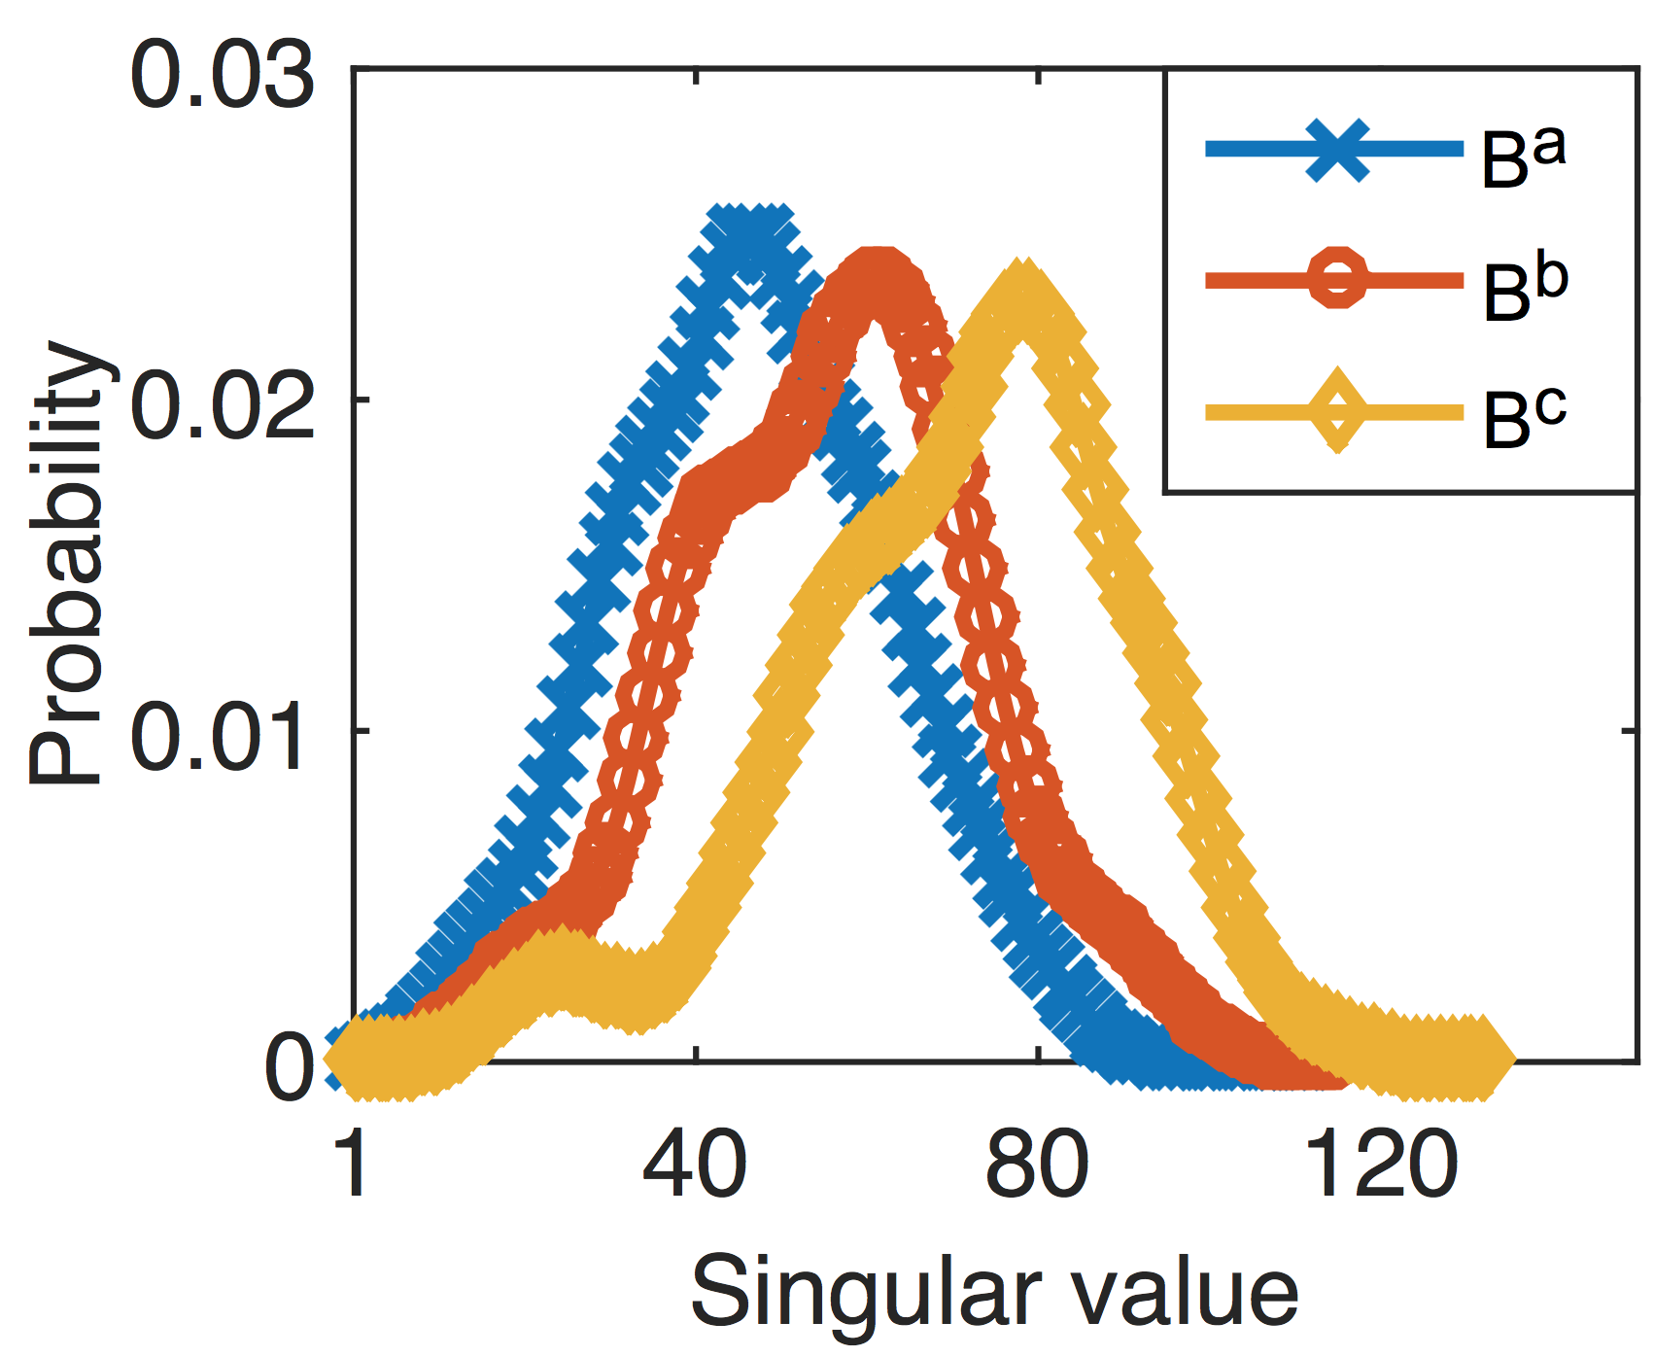
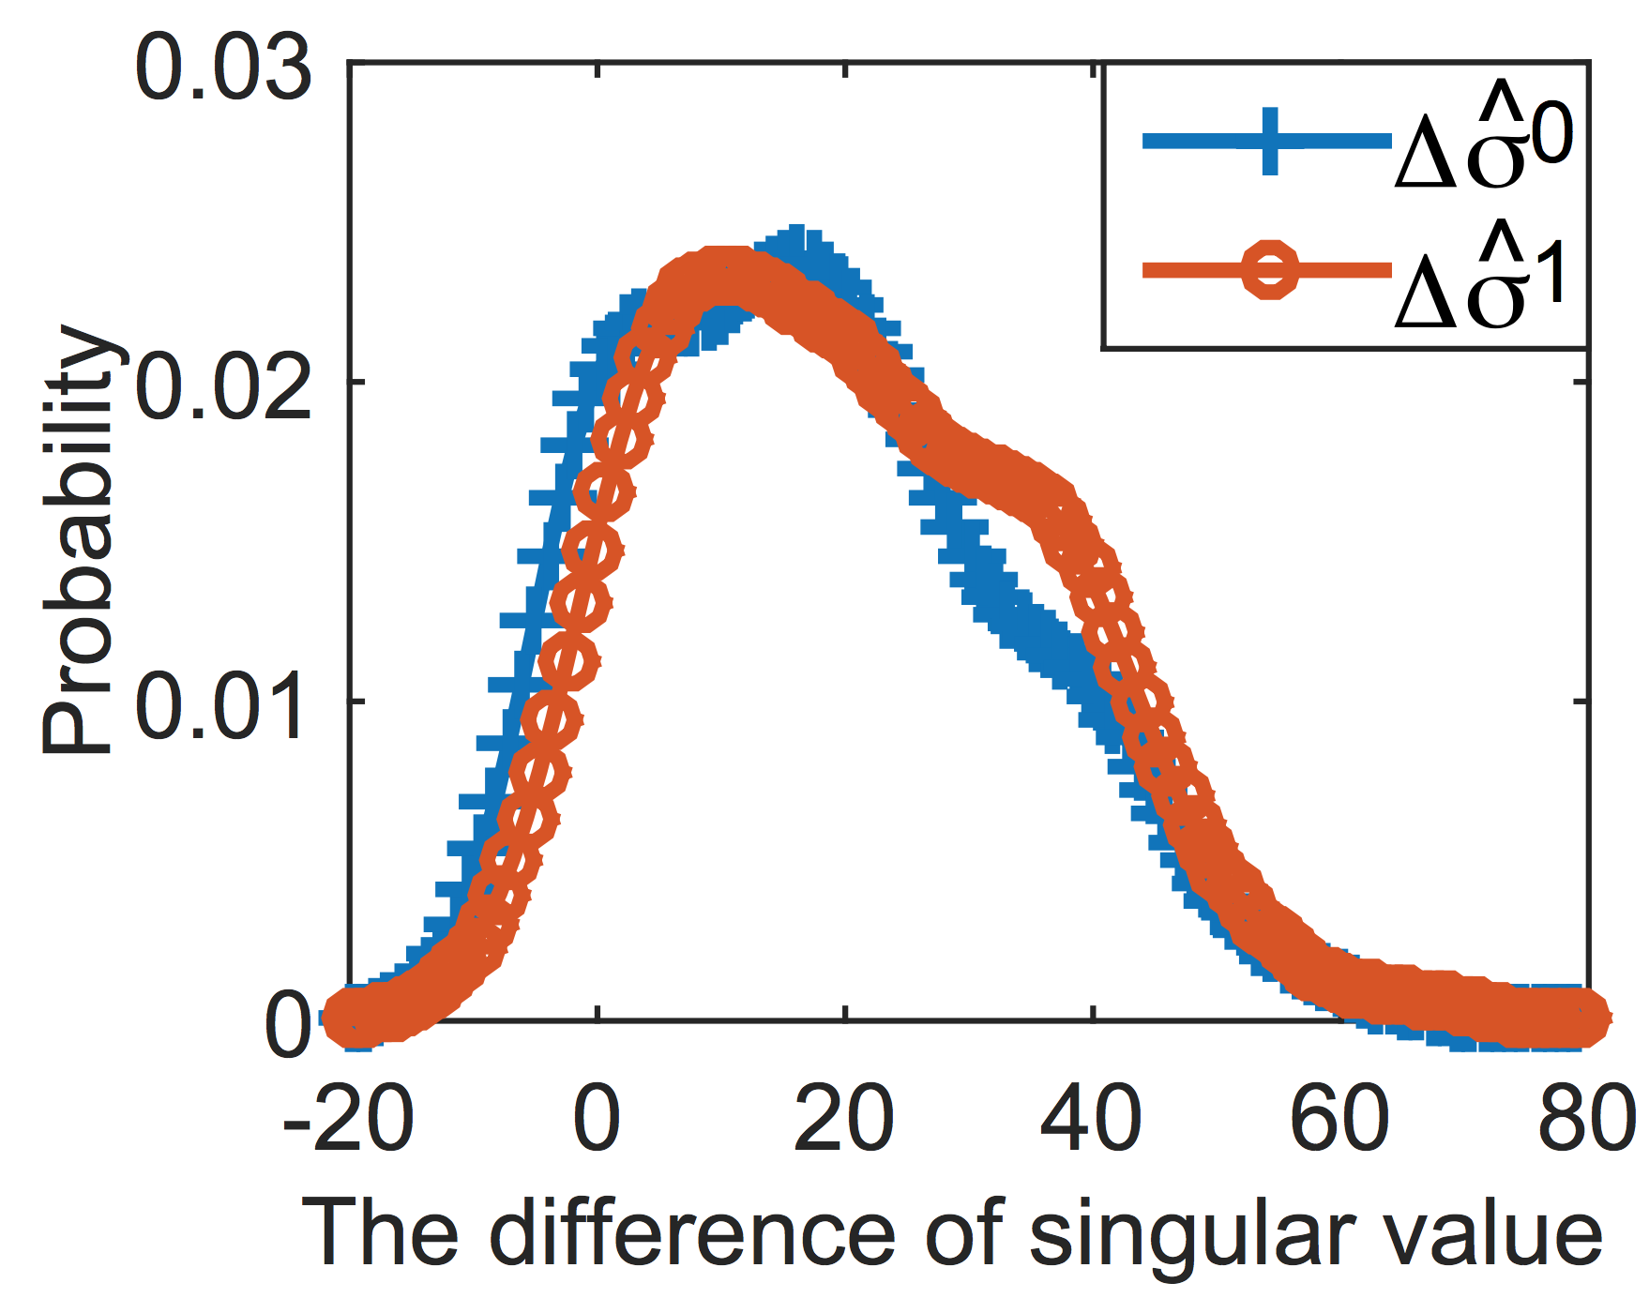
Distributions of S-box
Distributions of singular value
Distributions of differences of singular value
Their distributions are distinct, although there is still a large overlapped area.
Their distributions are almost identical.
ACM CCS 2016 – The Dancing Signals (TDS)
15
Notes:
The reason that we use the difference of singular values, say G0 - G1,
is because the distribution of the singular values are non-identity distributed.
As the example shown in the left figure, if we choose the feature 40,
Eve will be with high probable to guess that the block comes from A .
Hence, we use the difference between singular values to represent 0 or 1 bit. Fortunately, our experiment shows that they are almost identity distributed.

Slide 16


Max Weight Matching
Ma Weight Matching
33
28
25
16
17
25
33
28
25
16
17
25
13
7
7
7
13
15
4
7
2
12
5
10
Kuhn-Munkres
Algorithm
18
24
32
18
29
20
18
24
32
18
29
20
D_{mean} = 7.5
D_{min} = 2
D_{mean} = 9.5
D_{min} = 7
$$σ_{0}$$
Singular Value of Group 1
$$σ_{1}$$
Singular Value of Group 2
ACM CCS 2016 – The Dancing Signals (TDS)
16
Notes:
another challenge emerges—there must be some feature pairs are too close to distinguish. For example, the left picture denotes some groups of feature denotes “0” and “1”. The features of 4th group are too similar that Bob may mis-match when Alice use this group to deliver key. To solve this problem, we use K-M algorithm to re-match the group to achieve max weight matching as shown in the right picture. We see that the mean and minimum distance between different groups is enlarged significantly.

Slide 17
Security of TDS
Security of TDS
Authenticity
Confidentiality
text
Eve can obtain the key based on her observation when and only when her bit error rate (BER) <7%.
Indeed, her BER approximates 50% when she is over 12cm away from legitimate users.
In public channel, the delivered singular values of 0-block and 1-block have identical distributions. Hence, the eavesdropper cannot improve its guess.
ACM CCS 2016 – The Dancing Signals (TDS)
17
Notes:
Now, I will discuss and analyze the security and efficiency of TDS.

Slide 18
Stability of TDS
Feature Extraction
Pairing
text
TDS extracts the feature of block based on SVD. The second or third singular values of the block is stable even if some measurements in the block are affected by noise.
TDS uses KM algorithm to maximize the difference between feature values for each 0/1 pair to further enhance the fault tolerance .
ACM CCS 2016 – The Dancing Signals (TDS)
18

Slide 19
Efficiency of TDS
Information delivery rate
Multiuser key agreement
text
We adjust block size n based on environmental dynamics. We set n = 4 and n = 6 in mobile and static scenarios, respectively. Hence, each sample can deliver 1.5 bits and 0.67 bit confidentially .
To support key agreement for more users, Alice and Bob ping each other to generate symmetric random channel variations. This model can double the authentication space.
ACM CCS 2016 – The Dancing Signals (TDS)
19

Slide 20
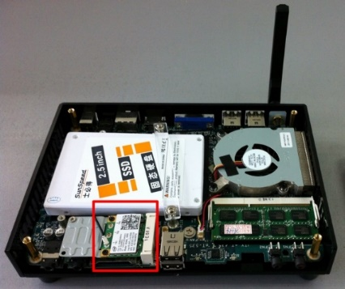
Experiment setup
As the AP, Peter broadcasts beacons every 50ms.
Alice broadcasts Timing Synchronization Function (TSF) timestamp to synchronize all legitimate devices within 25 microseconds.
Index | State | Environment
A | Static | Indoor
B | Static | Outdoor
C | Mobile | Indoor
D | Mobile | Outdoor
Antennas of Alice, Bob and Calvin are located in less than 5cm distance, while Eve is deployed at least 25cm away from Alice.
Linux 802.11n CSI Tool & Intel 5300 NIC
ACM CCS 2016 – The Dancing Signals (TDS)
20
Notes:
After introduce the details of TDS, I will present the prototype implementation, experiment setup, and performance evaluation of our system. In our prototype, Antennas of Alice, Bob and Calvin are located in less than 5cm distance, while Eve is deployed at least 25cm away from Alice. As the AP, Peter broadcasts beacons every 50ms. Alice broadcasts Timing Synchronization Function (TSF) timestamp to synchronize all legitimate devices within 25 microseconds. We setup four different scenarios as shown in the table.

Slide 21
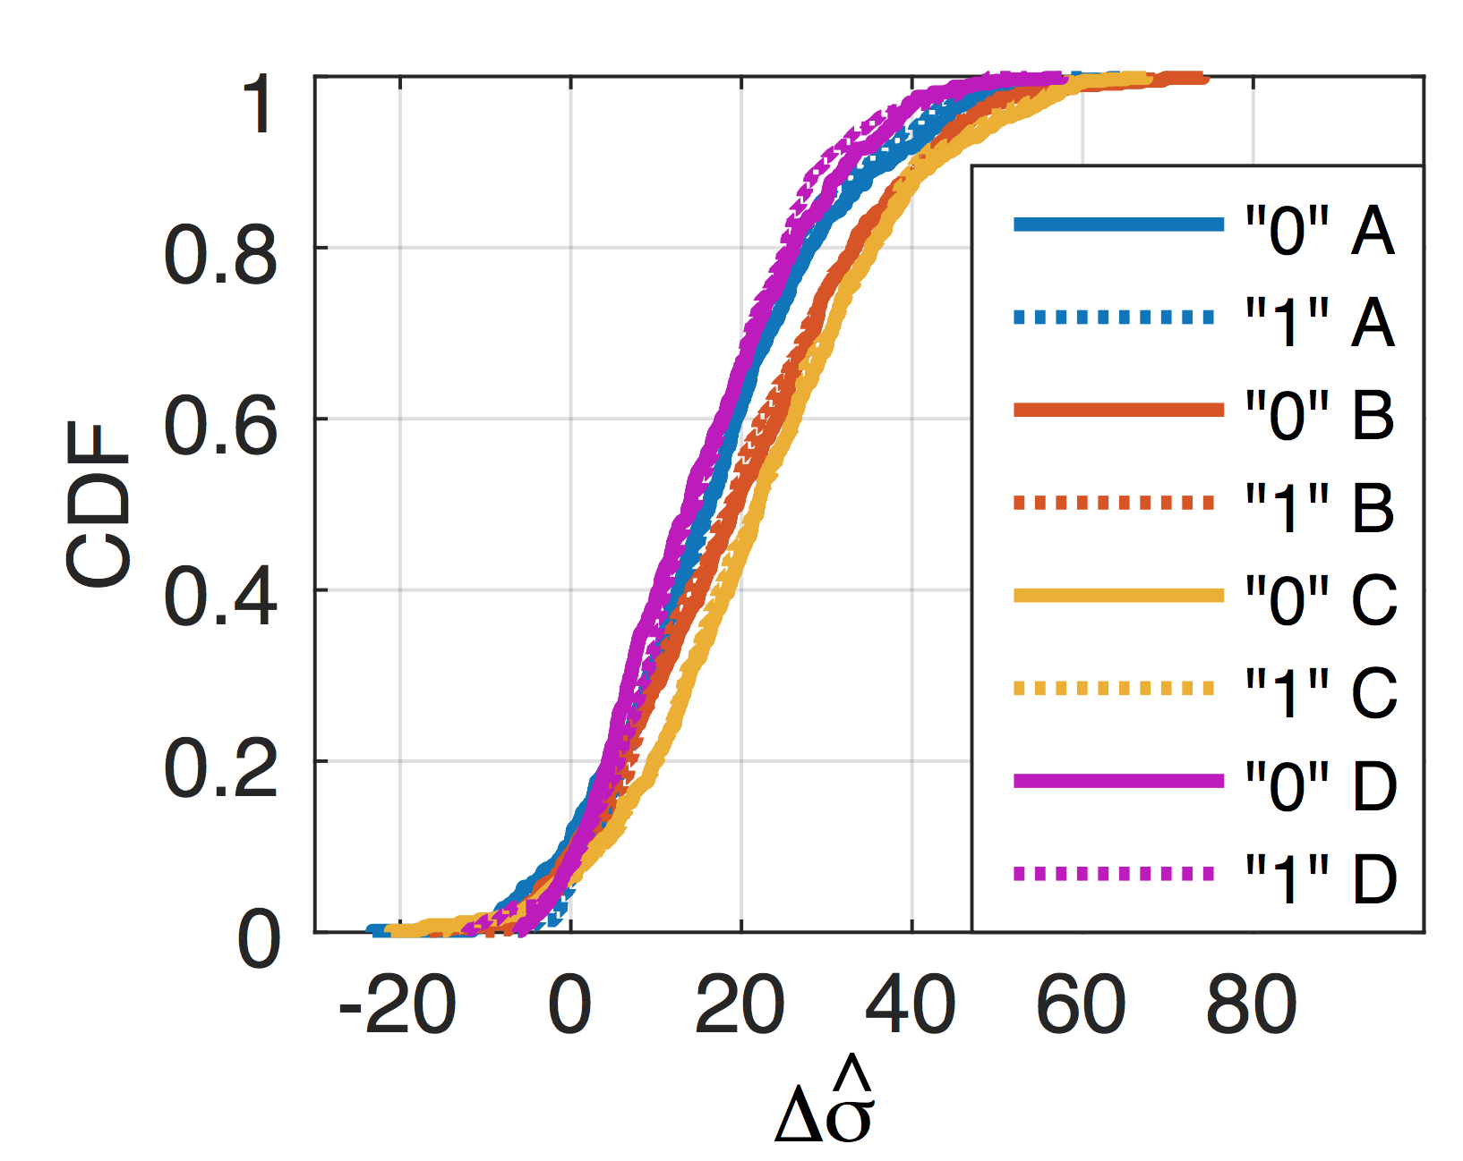
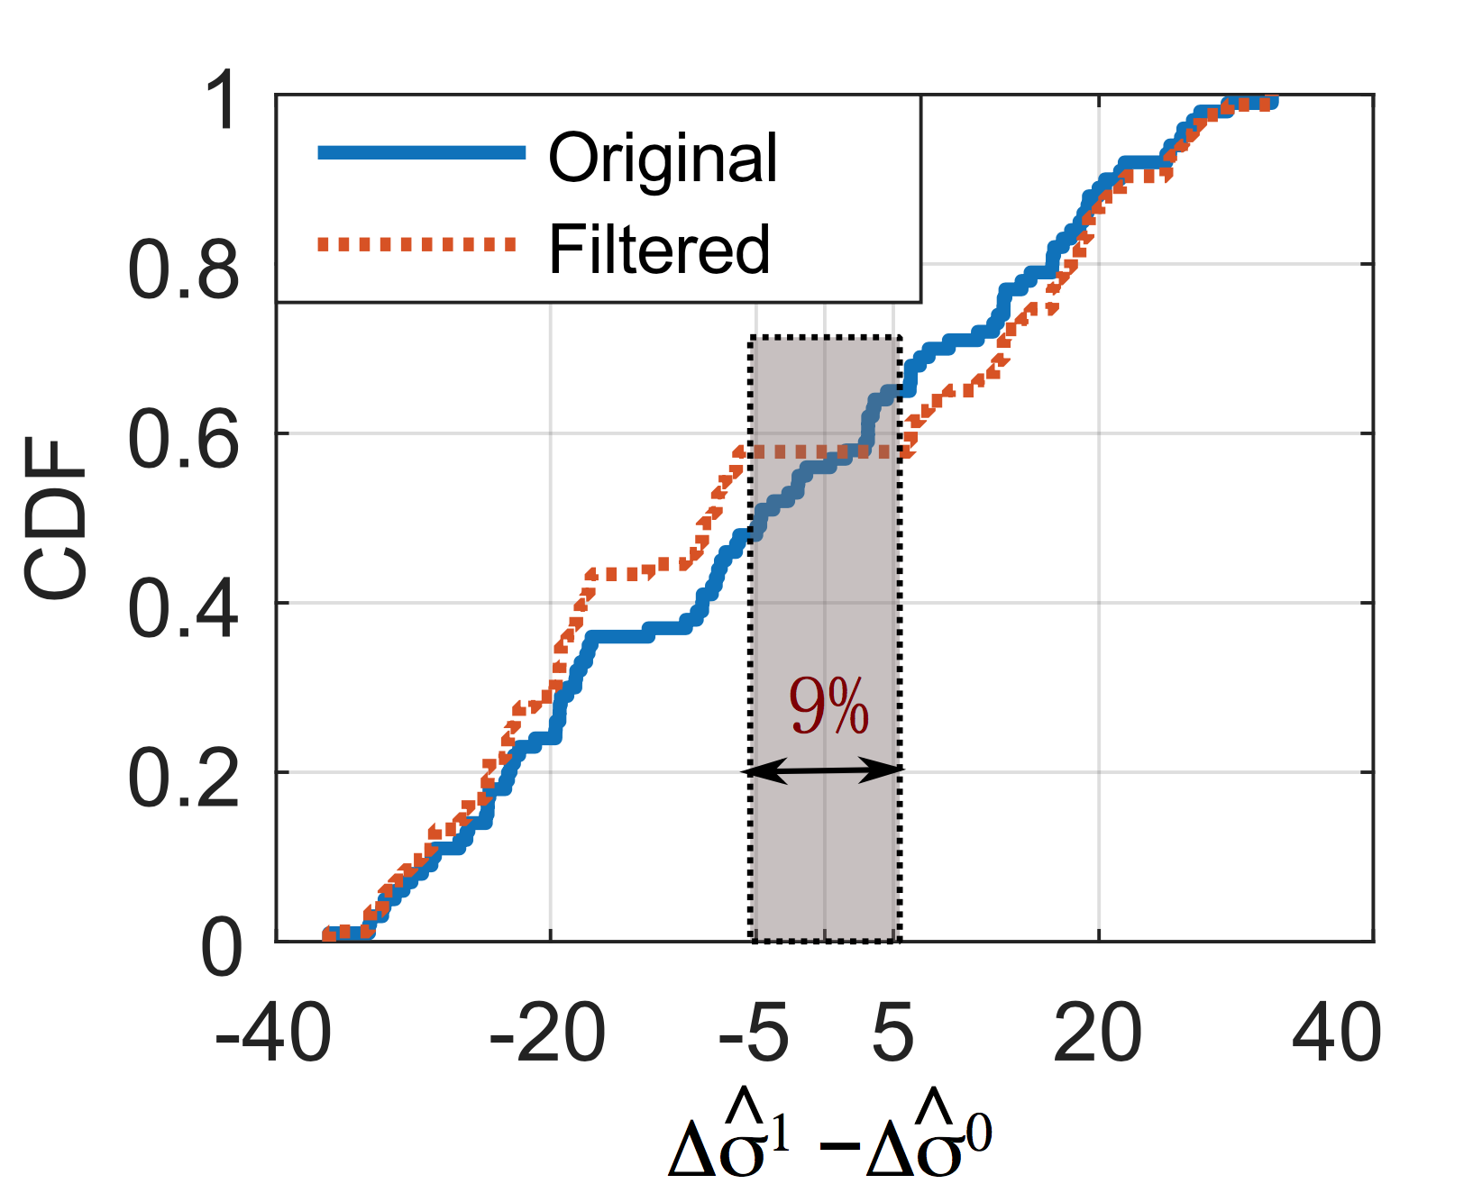
Distribution of S-box
Distribution of differences
between 0 and 1
Feature distribution of 0 and 1
The distributions in different scenarios are slightly different. In the same scenario, 0 and 1 have extremely similar distributions.
The differences for original 0/1 pair are nearly a linear distribution. There are about 9% pairs with the differences less than 10. We introduce a filtered perfect matching method to filter the pairs with small differentiation.
ACM CCS 2016 – The Dancing Signals (TDS)
21
Notes:
Since the distribution of 0/1 feature influences the security of whole system, we will evaluate it firstly. From the left figure, we can see that the distributions in different scenarios are slightly different. In the same scenario, 0 and 1 have extremely similar distributions. The right figure show that the differences for original 0/1 pair are nearly a linear distribution. There are about 9% pairs with the differences less than 10. We introduce a filtered perfect matching method to filter the pairs with small differentiation.

Slide 22
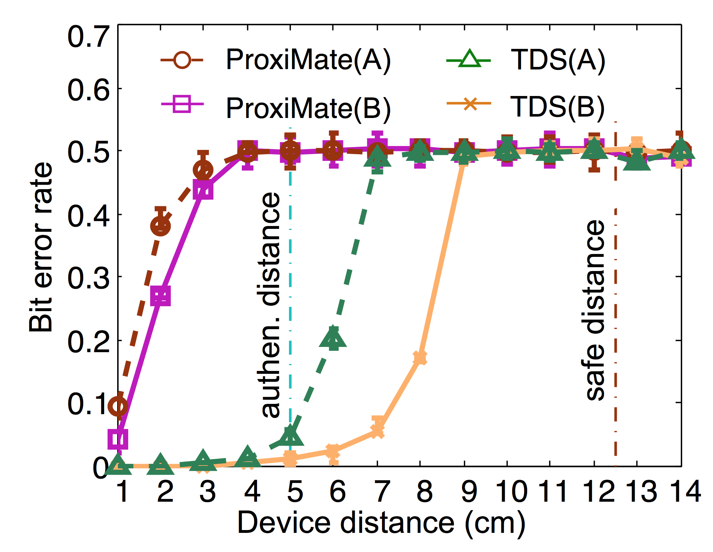
Authentication distance
Even if the distance of two device antennas is 1cm, the bit error rate of ProxiMate is about 5%-10%.
For TDS, when the distance is less than 3cm, the mismatch rate of TDS is 0 for outdoor environments and < 0.015 for indoor environments. When the distance is 5cm, the mismatch rate of TDS is still smaller than 7%.
Fair price with extra services
Past project maintenance up to 1 month
Authenticated distance - 5 cm @ 2.4 GHz
Safe distance – 12.5 cm @ 2.4 GHz
ACM CCS 2016 – The Dancing Signals (TDS)
22
Notes:
Authentication distance directly impacts the usability of our method. Our goal is to increase the authentication distance as long as possible. This figure compares the performance between TDS and ProxiMate. Obviously, even if the distance of two device antennas is 1cm, the bit error rate of ProxiMate is about 5%-10%. For TDS, when the distance is less than 3cm, the mismatch rate of TDS is 0 for outdoor environments and < 0.015 for indoor environments. When the distance is 5cm, the mismatch rate of TDS is still smaller than 7%.

Slide 23
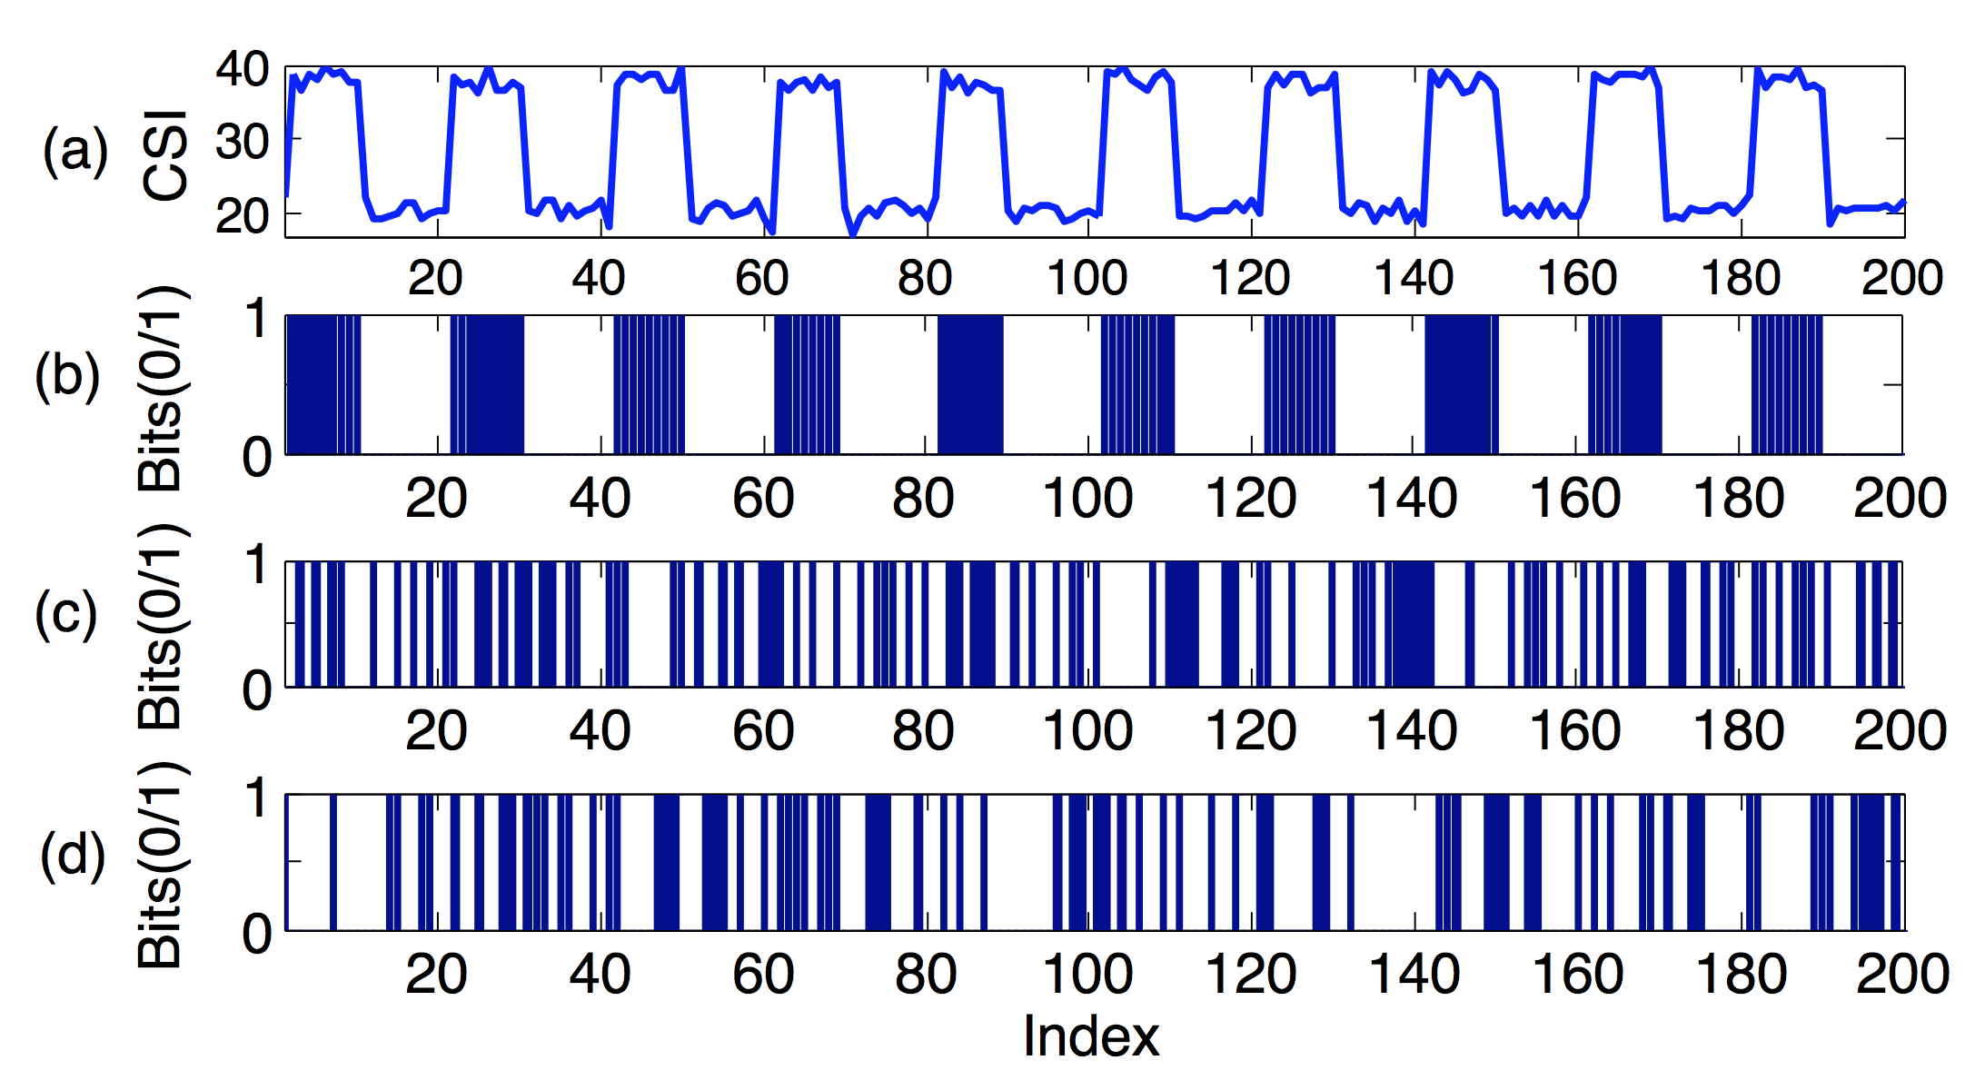
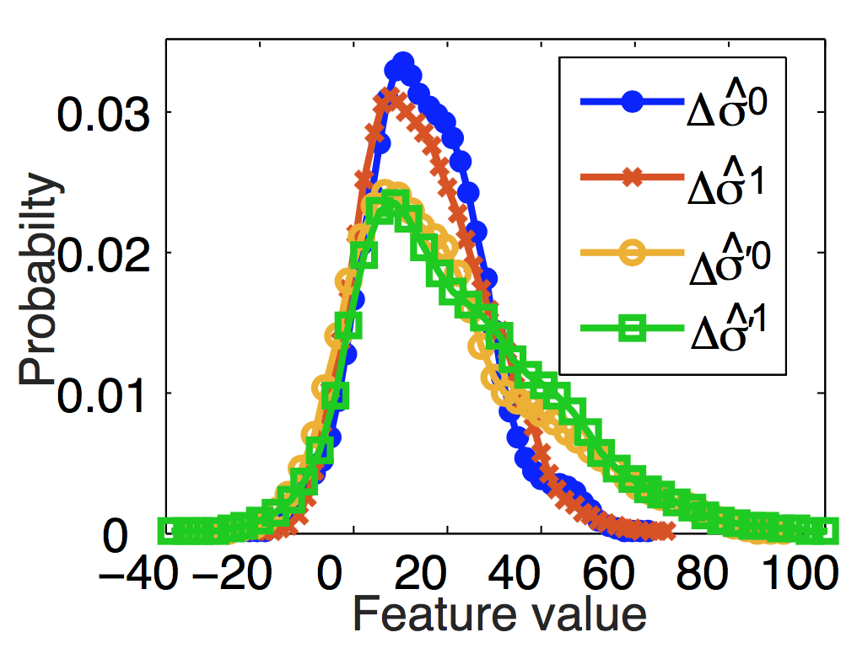
Predictable channel attack
Since the feature is extracted from the public Wi-Fi source, attacker can perform some deliberately planned movements to affect the channel and the feature.
ACM CCS 2016 – The Dancing Signals (TDS)
23
Notes:
Since the feature is extracted from the public wifi source, attacker can perform some deliberately planned movements to affect the channel and the feature. The variations of extracted bits by TDS are independent of the blocking pattern. It is because TDS do not rely on the channel condition to generate keys. Therefore, an attacker cannot infer the pattern of the secret bits by TDS based on his interference pattern. The right figure compares the distribution of delivering value with/without predictable channel attack. It reveals that the features represented 0s and 1s are almost identically distributed regardless of predictable channel attack. This is because that the block allocation sufficiently diffuse and confuse the CSI measurements. More interesting, the distribution range of 0’ feature grows wider, since the predictable channel attack introduce more variance of measurements. It increases the difference between the features of 0 and 1 for each bit, which improves fault-tolerance of S-box. Therefore, TDS can effectively defend against predictable channel attacks.

Slide 24
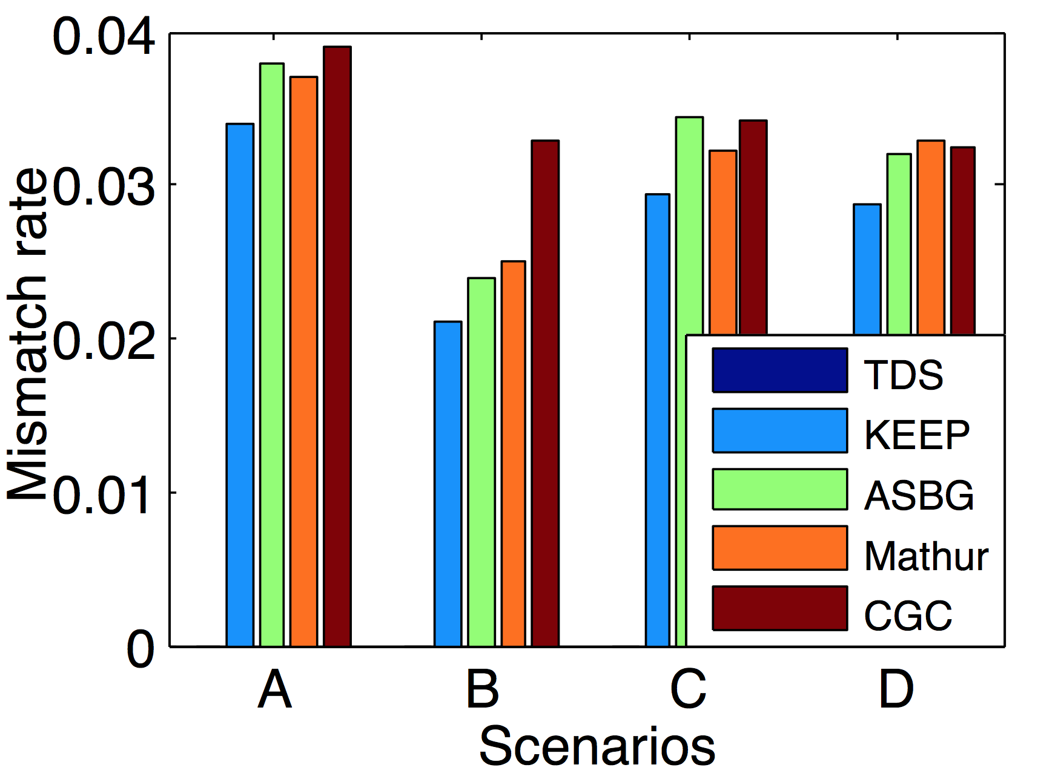
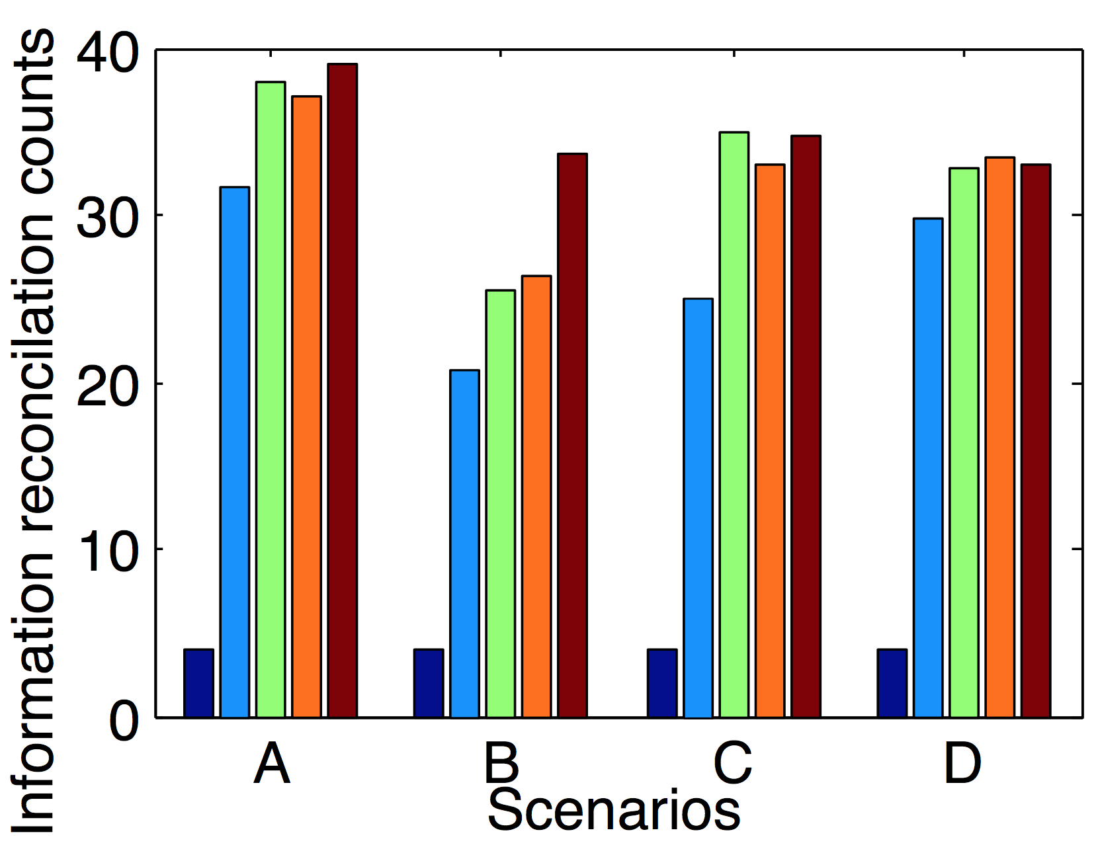
Performance comparison
Bit error rate
Information reconciliation counts
TDS has no mismatched bit, while other methods may cause around 2% to 4% mismatched bits.
Since there are no mismatched bit, TDS only uses 4 times pass check to guarantee the consistency of transmitted secret bits.
ACM CCS 2016 – The Dancing Signals (TDS)
24
Notes:
Besides authentication, TDS can also used for secrete key extraction. For this kind of application, Alice and Bob ping each other to establish a common cryptographic key based on Reciprocity of Radio Wave Propagation. We compare the performance among TDS and state-of-the-art RF-based approaches.

Slide 25
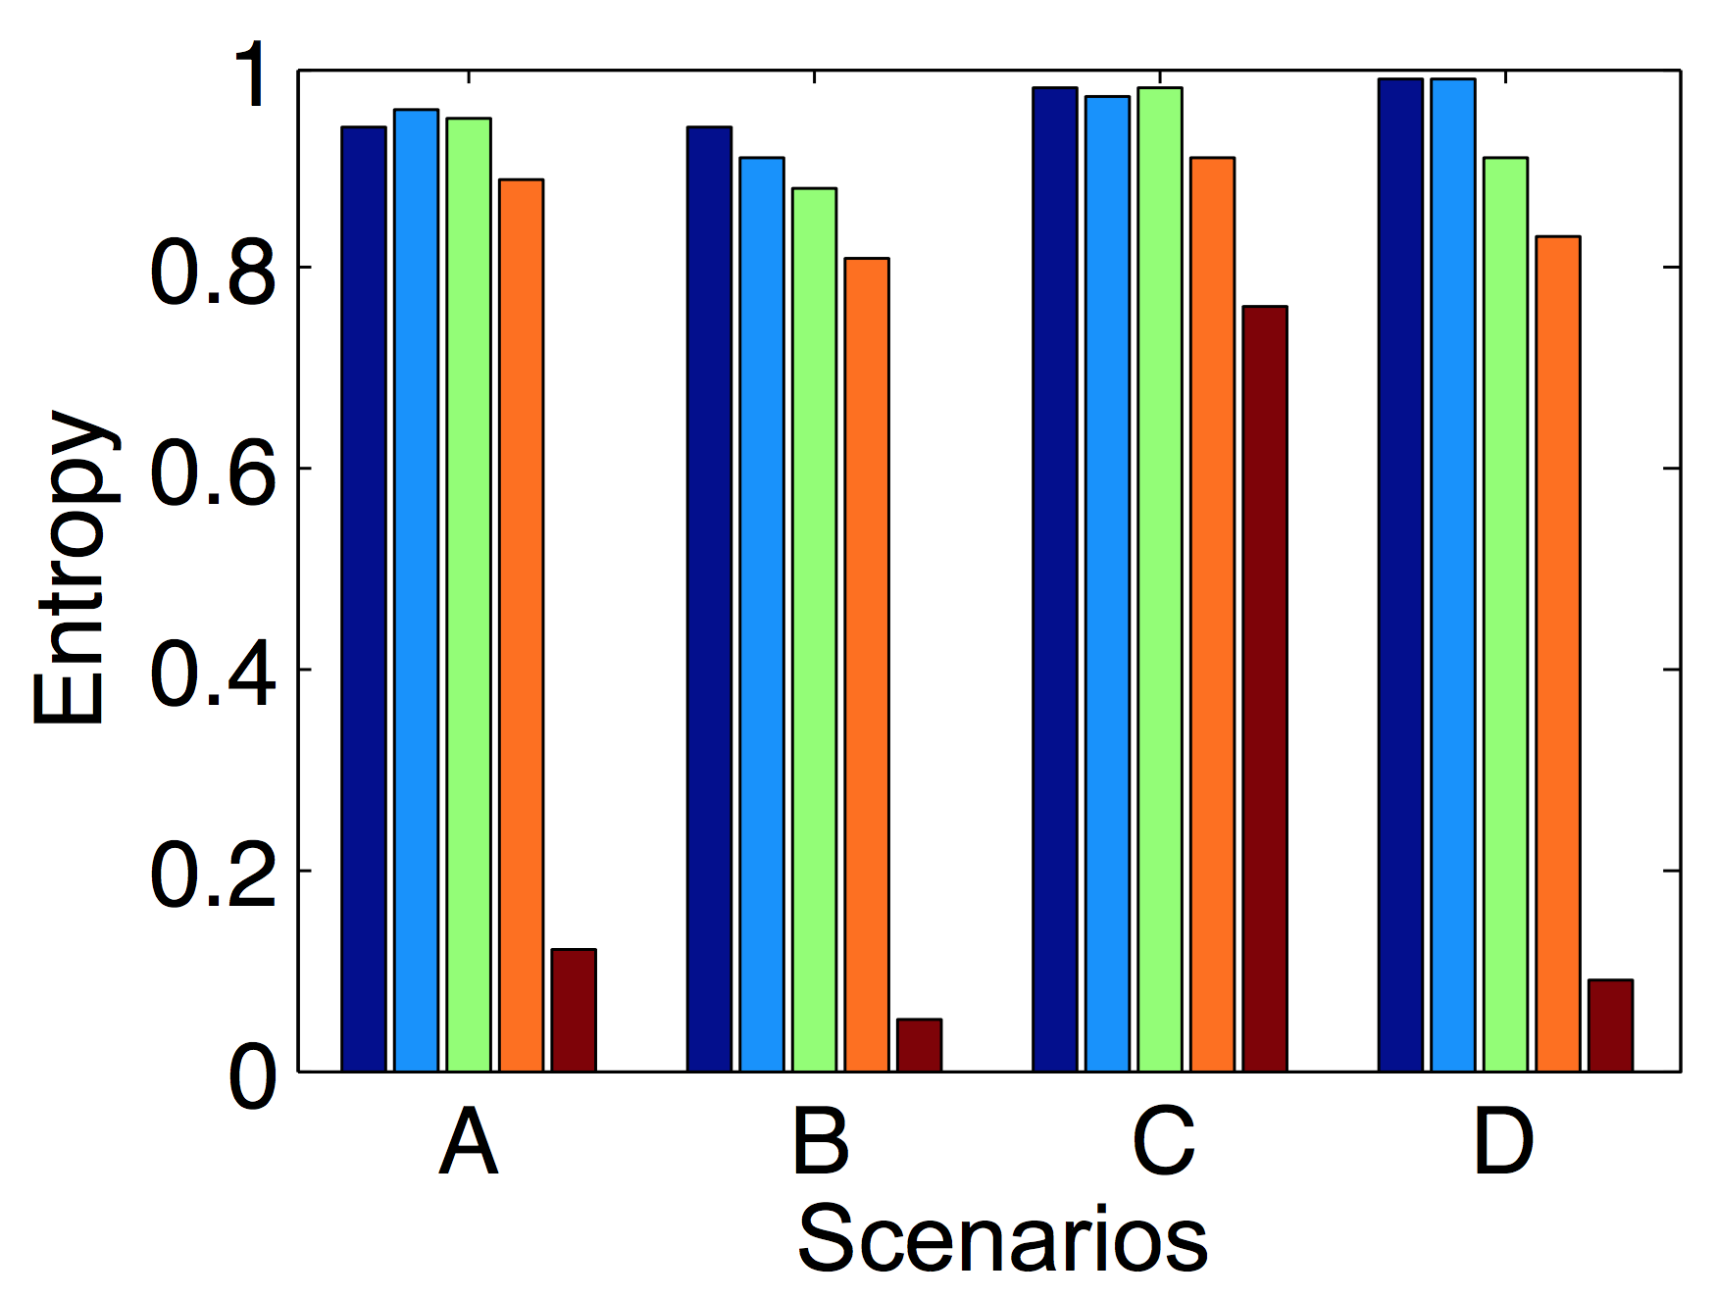
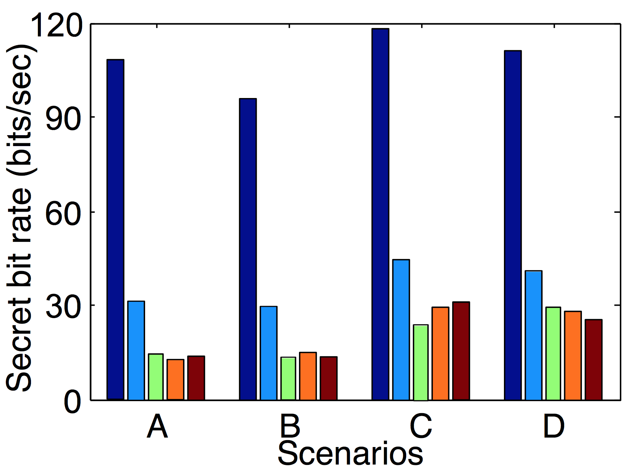
Performance comparison
Entropy
Secret bit generation rate
TDS and KEEP have the highest entropy in all methods, and CGC has the lowest.
Bit generation rate of TDS is slower than previous results. It is because in this set of experiments,
Alice and Bob do not listen to a public WiFi but use the communication among them for sampling. This
is the only model that the other protocols can work but TDS is not restricted to it.
ACM CCS 2016 – The Dancing Signals (TDS)
25

Slide 26

Conclusion
TDS uses substitution-based confidential bits delivery instead of quantization-based key extraction.
We propose a similarity-based symmetric encryption protocol to achieve fast D2D authentication using CSI.
It can be used to transmit any information, including self-generated session keys.
The proposed similarity-based block feature matching mechanism significantly improves fault tolerance and increases the authentication distance from 0.1λ to 0.5λ, approaching the distance upper bound for small-scale fading.
TDS only takes a couple of seconds to make devices agree on a 256-bit secret key with high entropy.
ACM CCS 2016 – The Dancing Signals (TDS)
26
Notes:
Finally, I will conclude our work. We propose a similarity-based symmetric encryption protocol to achieve fast D2D authentication using CSI. TDS uses substitution-based confidential bits delivery instead of quantization-based key extraction. It can be used to transmit any information, including self-generated session keys. The proposed similarity-based block feature matching mechanism significantly improves fault tolerance and increases the authentication distance from 0.1λ to 0.5λ, approaching the distance upper bound for small-scale fading. TDS only takes a couple of seconds to make devices agree on a 256-bit secret key with high entropy.

Slide 27

Thank you!
For more info please contact us:
Email: weixi.cs@gmail.com
pvc.xjtu.edu.cn
ACM CCS 2016 – The Dancing Signals (TDS)

